Slide 1



Slide 2


Aptis Writing Part 4 –
Letter/email
Writing a personal or formal letter which requires you to do one or more of the following:
Express wants, requirements, likes and dislikes, concerns.
Give opinions
Make complaints
Explain your reasons
Explain how to do something
Ask for or give information

Slide 3
Aptis Writing Part 4 –
Letter/email
Skills Being Tested:
  Ability to clearly describe and expand upon the information presented.
  How well you can organize the information
  Accuracy of your use of language
Register or Style: Formal/Polite

Slide 4
Descriptors – Writing
C | Can write clear, smoothly flowing, complex texts in an appropriate and effective style and a logical structure which helps the reader to find significant points.
B2 | Can write clear, detailed texts on a variety of subjects related to his/her field of interest and shows an ability to use different registers within written texts
B1 | Can write straightforward connected texts on a range of familiar subjects within his field of interest, by linking a series of shorter discrete elements into a linear sequence.
A2 | Can write a series of simple phrases and sentences linked with simple connectors like ‘and’, ‘but’ and ‘because’
A1 | Can write simple isolated phrases and sentences.
A0 | Not enough language knowledge demonstrated to allow for any meaningful inferences about the candidate’s ability.

Slide 5
Assessment Criteria
Clear & effective style
  How effectively you have identified, illustrated and reported the key features of the information in the task
Smoothly flowing, logical structure
  How well the information and ideas are organized, and how well the information is linked
Vocabulary
  The range of vocabulary used, how accurately it is used and how appropriate it is for the task
Grammar
- The range of structures used, how accurately they are used and how appropriate they are for the task

Slide 6
Assessment Criteria
Understand information that is presented in the question
Choose how you will organize the information in paragraphs
Be sure to start with a salutation line and appropriate lead-in phrase
Be sure to finish with a stock phrase and sign off line
Be sure to make questions relevant

Slide 7
Lead-in Phrases
I am writing to you -because…
-to let you know that….
-to advise you that….
-in reply to your recent letter…
I am anxious to obtain some information from you about…
It is with regret that I write to you advising you that…
I regret to inform you that…
I am sorry to let you know that…
As you are probably already aware…

Slide 8
Final Sentence
Stock Phrases
I look forward to your reply.
I look forward to hearing from you in the future.
I would be very grateful if you would attend to this matter as soon as possible.
I await your reply in anticipation.
Thank you for your co-operation in this matter.
Thank you for your co-operation and I hope to hear from you shortly.
Please do not hesitate to contact me if you have any queries about this matter.
I am sorry to have caused you any trouble and I trust that you will understand.

Slide 9
Sign off Phrases
Yours sincerely,
Yours faithfully,
Regards,
Informal
Yours truly,
Best wishes,
Love,

Slide 10
Making questions
Relevant and Polite
Ask the question after the problem is explained.
Example:
First of all, I need to know if it is too late to enroll in the course. Can you write and tell me if there are any places available? I certainly hope that my enrolment is still possible.
Avoid asking a question if it is not completely clear why it’s being asked.

Slide 11
Making questions
Relevant and Polite
It is better to ask a question using a longer more polite form than a shorter more direct form.
Such as:
‘Can you write to me and tell me if…’
‘Do you happen to know why…’
‘Would you be kind enough to…’

Slide 12
LAYOUT A
Dear Sir, I am writing to you because I am unable to pay next month’s rent which is due on Saturday. Unfortunately, the other day I lost my wallet, and there was a large amount of money inside. I have, therefore, had to write to my parents to ask them to send me some money urgently. As soon as it arrives, I will immediately notify you and arrange to pay by cash or cheque. I hope that this does not cause you much inconvenience. There are also some problems with the flat that I wish to bring to your attention. First, the cold tap in the bathroom will not turn off properly, and the water is dripping constantly. This will need to be fixed quickly because it is wasting water. Second, one of the back burners on the top of the oven does not work at all. I’m sorry that I cannot pay the rent on time, and trust that you will understand.
Yours sincerely
Jane Citizen

Slide 13
LAYOUT B
Dear Sir,
I am writing to you because I am unable to pay next month’s rent which is due on Saturday. Unfortunately, the other day I lost my wallet, and there was a large amount of money inside. I have, therefore, had to write to my parents to ask them to send me some money urgently. As soon as it arrives, I will immediately notify you and arrange to pay by cash or cheque. I hope that this does not cause you much inconvenience.
There are also some problems with the flat that I wish to bring to your attention. First, the cold tap in the bathroom will not turn off properly, and the water is dripping constantly. This will need to be fixed quickly because it is wasting water. Second, one of the back burners on the top of the oven does not work at all.
I’m sorry that I cannot pay the rent on time, and trust that you will understand.
Yours sincerely
Jane Citizen

Slide 14
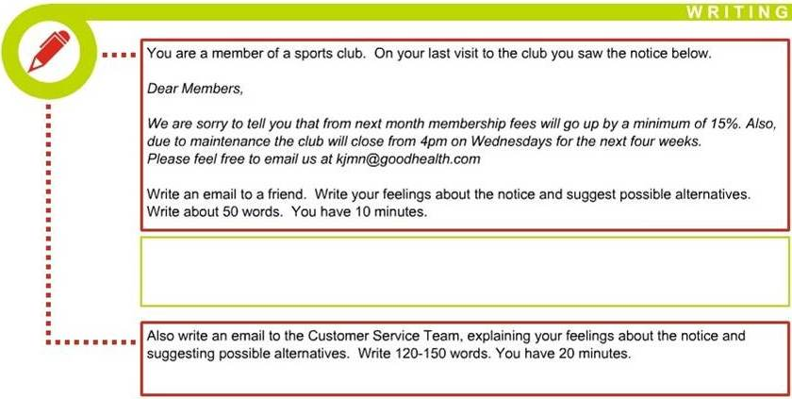
SAMPLE
You do NOT need to write any addresses.
Begin your letter as follows:
Dear……

